Slide 1
PCIe Slot 13 CPU2 x16
PCIe Slot 9 CPU2 x8 ((NVMe 1.6 TB)
PCIe Slot 5 CPU0 x8
PCIe Slot 1 CPU0 x8 ((NVMe 1.6 TB)
2 Port
Chassis #4
PCIe Slot 14 CPU3 x8 ((NVMe 1.6 TB)
PCIe Slot 10 CPU2 x16
PCIe Slot 6 CPU1 x8 ((NVMe 1.6 TB)
PCIe Slot 2 CPU0 x16
**CONFIDENTIAL**
COMCAST PoC Setup Plan
p1n1
p1n1
PCIe Slot 15 CPU3 x16
PCIe Slot 11 CPU2 x8 ((NVMe 1.6 TB)
PCIe Slot 7 CPU1 x16
PCIe Slot 3 CPU0 x8
PCIe Slot 16 CPU3 x8
PCIe Slot 12 CPU3 x16
PCIe Slot 8 CPU1 x8 ((NVMe 1.6 TB)
PCIe Slot 4 CPU1 x16
(1.8 TB * 4 SATA SSD = 7.2 TB RAID1)
BASE I/O or BMC
(128GB * 24 DDR4 RAM = 3TB RAM)
BPS0
BPS1
ASIC FAN
BPS 2
BPS 3
PCIe Slot 13 CPU2 x16
PCIe Slot 9 CPU2 x8 ((NVMe 1.6 TB)
PCIe Slot 5 CPU0 x8
PCIe Slot 1 CPU0 x8 ((NVMe 1.6 TB)
2 Port
Subnet1
Chassis #3
PCIe Slot 14 CPU3 x8 ((NVMe 1.6 TB)
PCIe Slot 10 CPU2 x16
PCIe Slot 6 CPU1 x8 ((NVMe 1.6 TB)
PCIe Slot 2 CPU0 x16
p1n1
p1n1
SWITCH 10/25G
PCIe Slot 15 CPU3 x16
PCIe Slot 11 CPU2 x8 ((NVMe 1.6 TB)
PCIe Slot 7 CPU1 x16
PCIe Slot 3 CPU0 x8
PCIe Slot 16 CPU3 x8
PCIe Slot 12 CPU3 x16
PCIe Slot 8 CPU1 x8 ((NVMe 1.6 TB)
PCIe Slot 4 CPU1 x16
(1.8 TB * 4 SATA SSD = 7.2 TB RAID1)
BASE I/O or BMC
(128GB * 24 DDR4 RAM = 3TB RAM)
8 Port
Isolated
Network
Subnet2
BPS0
BPS1
ASIC FAN
BPS 2
BPS 3
bond0
Bond mode = lacp mode
BONDING_OPTS="mode=4 miimon=500 updelay=1000"
PCIe Slot 13 CPU2 x16
PCIe Slot 9 CPU2 x8 ((NVMe 1.6 TB)
PCIe Slot 5 CPU0 x8
PCIe Slot 1 CPU0 x8 ((NVMe 1.6 TB)
2 Port
Chassis #2
PCIe Slot 14 CPU3 x8 ((NVMe 1.6 TB)
PCIe Slot 10 CPU2 x16
PCIe Slot 6 CPU1 x8 ((NVMe 1.6 TB)
PCIe Slot 2 CPU0 x16
p1n1
p1n1
Subnet3
PCIe Slot 15 CPU3 x16
PCIe Slot 11 CPU2 x8 ((NVMe 1.6 TB)
PCIe Slot 7 CPU1 x16
PCIe Slot 3 CPU0 x8
Size | Mount Point | File System
500MB | /boot/efi | VFAT
2G | /boot | XFS
300GB | / | XFS
200GB | /tmp | XFS
400GB | /var | XFS
32GB | Swap | SWAP
500 GB | /home | XFS
1.8 TB SATA SSD [ Separate disk ] | /trovares_POC | XFS
1.8 TB SATA SSD [ Separate disk ] | /ReservoirLab_POC | XFS
24 * 1.6 TB NVMe Drives | /nvme_data1 /nvme_data2 /nvme_data3 /nvme_data4 /nvme_data5 /nvme_data6 /nvme_data7 /nvme_data8 | /nvme_data9 /nvme_data10 /nvme_data11 /nvme_data12 /nvme_data13 /nvme_data14 /nvme_data15 /nvme_data16
PCIe Slot 16 CPU3 x8
PCIe Slot 12 CPU3 x16
PCIe Slot 8 CPU1 x8 ((NVMe 1.6 TB)
PCIe Slot 4 CPU1 x16
(1.8 TB * 4 SATA SSD = 7.2 TB RAID1)
BASE I/O or BMC
(128GB * 24 DDR4 RAM = 3TB RAM)
BPS0
BPS1
ASIC FAN
BPS 2
BPS 3
PCIe Slot 13 CPU2 x16
PCIe Slot 9 CPU2 x8 ((NVMe 1.6 TB)
PCIe Slot 5 CPU0 x8
PCIe Slot 1 CPU0 x8 ((NVMe 1.6 TB)
2 Port
Chassis #1
PCIe Slot 14 CPU3 x8 ((NVMe 1.6 TB)
PCIe Slot 10 CPU2 x16
PCIe Slot 6 CPU1 x8 ((NVMe 1.6 TB)
PCIe Slot 2 CPU0 x16
p1n1
p1n1
PCIe Slot 15 CPU3 x16
PCIe Slot 11 CPU2 x8 ((NVMe 1.6 TB)
PCIe Slot 7 CPU1 x16
PCIe Slot 3 CPU0 x8
PCIe Slot 16 CPU3 x8
PCIe Slot 12 CPU3 x16
PCIe Slot 8 CPU1 x8 ((NVMe 1.6 TB)
PCIe Slot 4 CPU1 x16
(1.8 TB * 4 SATA SSD = 7.2 TB RAID1)
BASE I/O or BMC
(128GB * 24 DDR4 RAM = 3TB RAM)
BPS0
BPS1
ASIC FAN
BPS 2
BPS 3

Slide 2
PCIe Slot 13 CPU2 x16
PCIe Slot 9 CPU2 x8 ((NVMe 1.6 TB)
PCIe Slot 5 CPU0 x8
PCIe Slot 1 CPU0 x8 ((NVMe 1.6 TB)
2 Port
Chassis #4
PCIe Slot 14 CPU3 x8 ((NVMe 1.6 TB)
PCIe Slot 10 CPU2 x16
PCIe Slot 6 CPU1 x8 ((NVMe 1.6 TB)
PCIe Slot 2 CPU0 x16
**CONFIDENTIAL**
COMCAST PoC Setup Plan
p1n1
p1n1
PCIe Slot 15 CPU3 x16
PCIe Slot 11 CPU2 x8 ((NVMe 1.6 TB)
PCIe Slot 7 CPU1 x16
PCIe Slot 3 CPU0 x8
PCIe Slot 16 CPU3 x8
PCIe Slot 12 CPU3 x16
PCIe Slot 8 CPU1 x8 ((NVMe 1.6 TB)
PCIe Slot 4 CPU1 x16
(1.8 TB * 4 SATA SSD = 7.2 TB RAID1)
BASE I/O or BMC
(128GB * 24 DDR4 RAM = 3TB RAM)
BPS0
BPS1
ASIC FAN
BPS 2
BPS 3
PCIe Slot 13 CPU2 x16
PCIe Slot 9 CPU2 x8 ((NVMe 1.6 TB)
PCIe Slot 5 CPU0 x8
PCIe Slot 1 CPU0 x8 ((NVMe 1.6 TB)
2 Port
Subnet1
Chassis #3
PCIe Slot 14 CPU3 x8 ((NVMe 1.6 TB)
PCIe Slot 10 CPU2 x16
PCIe Slot 6 CPU1 x8 ((NVMe 1.6 TB)
PCIe Slot 2 CPU0 x16
p1n1
p1n1
SWITCH 10/25G
PCIe Slot 15 CPU3 x16
PCIe Slot 11 CPU2 x8 ((NVMe 1.6 TB)
PCIe Slot 7 CPU1 x16
PCIe Slot 3 CPU0 x8
PCIe Slot 16 CPU3 x8
PCIe Slot 12 CPU3 x16
PCIe Slot 8 CPU1 x8 ((NVMe 1.6 TB)
PCIe Slot 4 CPU1 x16
(1.8 TB * 4 SATA SSD = 7.2 TB RAID1)
BASE I/O or BMC
(128GB * 24 DDR4 RAM = 3TB RAM)
8 Port
Isolated
Network
Subnet2
BPS0
BPS1
ASIC FAN
BPS 2
BPS 3
bond0
Bond mode = lacp mode
BONDING_OPTS="mode=4 miimon=500 updelay=1000"
PCIe Slot 13 CPU2 x16
PCIe Slot 9 CPU2 x8 ((NVMe 1.6 TB)
PCIe Slot 5 CPU0 x8
PCIe Slot 1 CPU0 x8 ((NVMe 1.6 TB)
2 Port
Chassis #2
PCIe Slot 14 CPU3 x8 ((NVMe 1.6 TB)
PCIe Slot 10 CPU2 x16
PCIe Slot 6 CPU1 x8 ((NVMe 1.6 TB)
PCIe Slot 2 CPU0 x16
p1n1
p1n1
Subnet3
PCIe Slot 15 CPU3 x16
PCIe Slot 11 CPU2 x8 ((NVMe 1.6 TB)
PCIe Slot 7 CPU1 x16
PCIe Slot 3 CPU0 x8
Size | Mount Point | File System
500MB | /boot/efi | VFAT
2G | /boot | XFS
300GB | / | XFS
200GB | /tmp | XFS
400GB | /var | XFS
32GB | Swap | SWAP
500 GB | /home | XFS
1.8 TB SATA SSD [ Separate disk ] | /trovares_POC | XFS
1.8 TB SATA SSD [ Separate disk ] | /ReservoirLab_POC | XFS
24 * 1.6 TB NVMe Drives | /nvme_data1 /nvme_data2 /nvme_data3 /nvme_data4 /nvme_data5 /nvme_data6 /nvme_data7 /nvme_data8 | /nvme_data9 /nvme_data10 /nvme_data11 /nvme_data12 /nvme_data13 /nvme_data14 /nvme_data15 /nvme_data16
PCIe Slot 16 CPU3 x8
PCIe Slot 12 CPU3 x16
PCIe Slot 8 CPU1 x8 ((NVMe 1.6 TB)
PCIe Slot 4 CPU1 x16
(1.8 TB * 4 SATA SSD = 7.2 TB RAID1)
BASE I/O or BMC
(128GB * 24 DDR4 RAM = 3TB RAM)
BPS0
BPS1
ASIC FAN
BPS 2
BPS 3
PCIe Slot 13 CPU2 x16
PCIe Slot 9 CPU2 x8 ((NVMe 1.6 TB)
PCIe Slot 5 CPU0 x8
PCIe Slot 1 CPU0 x8 ((NVMe 1.6 TB)
2 Port
xGT
Chassis #1
PCIe Slot 14 CPU3 x8 ((NVMe 1.6 TB)
PCIe Slot 10 CPU2 x16
PCIe Slot 6 CPU1 x8 ((NVMe 1.6 TB)
PCIe Slot 2 CPU0 x16
PCIe Slot 1 CPU0 x8 ((NVMe 1.6 TB)
p1n1
p1n1
PCIe Slot 15 CPU3 x16
PCIe Slot 11 CPU2 x8 ((NVMe 1.6 TB)
PCIe Slot 7 CPU1 x16
PCIe Slot 3 CPU0 x8
PCIe Slot 16 CPU3 x8
PCIe Slot 12 CPU3 x16
PCIe Slot 8 CPU1 x8 ((NVMe 1.6 TB)
PCIe Slot 4 CPU1 x16
(1.8 TB * 4 SATA SSD = 7.2 TB RAID1)
BASE I/O or BMC
(128GB * 24 DDR4 RAM = 3TB RAM)
BPS0
BPS1
ASIC FAN
BPS 2
BPS 3

Slide 3
Detecting Unknown cyber-attack patterns

Slide 4
DDoS Attack
Reflection-based DDoS
Attack in which attacker remains hidden using legitimate third-party components (Marshalled Attacks)
Packets are sent to reflector servers and source-ip is the victim server
Done to overwhelm the victim server
Exploitation-based attack
Attack in which attacker remains hidden using legitimate third-party components (Marshalled Attacks)
Packets are sent to reflector servers and source-ip is the victim server
Done to overwhelm the victim server
Very high no. of TCP/UDP packets are send on random ports
Network bandwidth gets exhausted, system crashes and performance degrades
Syn packets are flooded. Continuous Syn packets are sent until the server crashes
Disrupt connection between client and server
Typically used in Online Gaming

Slide 5
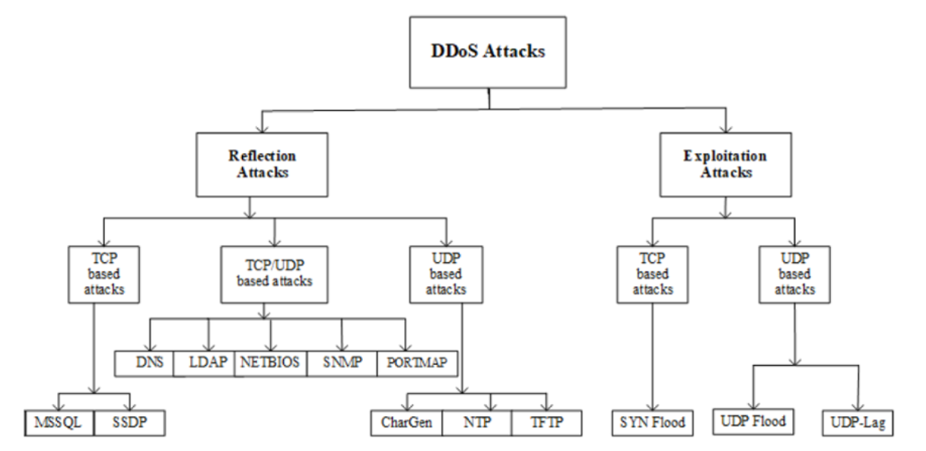

Slide 6
DDoS Attack – Syn Flood
Normal TCP Connection
Spoof the source ip
SYN
SYN
C
s
C
s
SYN-ACK
SYN-ACK
Missing final ack from malicious client
ACK
SYN
Flood the server with fictitious sny

Slide 7
CICDDoS2019 Dataset
abstract behaviour of 25 users based on the HTTP, HTTPS, FTP, SSH, and email protocols
Involved systems – 1 Server, Firewalls, 4 Client PCs (Windows 7, Windows Vista, Windows 8.1, Windows 10)
Confirmed DDoS Attacks
Training Day (12 Attacks) - NTP, DNS, LDAP, MSSQL, NetBIOS, SNMP, SSDP, UDP, UDP-Lag, WebDDoS, SYN and TFTP
Testing Day (7 Attacks) - PortScan, NetBIOS, LDAP, MSSQL, UDP, UDP-Lag and SYN
Dataset Duration – Between 12th Jan and 11th March
SYN attack timing:
First Day - 11:28 - 17:35
Second Day - 13:29 - 13:34
Data Format: pcap , csv
/nvme_data14/CICDataset/CICDDoS2019/Dataset/csv/01-12
[root@mdchawkeye 01-12]# du -chs *
5.2G combined_dataset
2.0G DrDoS_DNS.csv
875M DrDoS_LDAP.csv
1.8G DrDoS_MSSQL.csv
1.6G DrDoS_NetBIOS.csv
616M DrDoS_NTP.csv
2.1G DrDoS_SNMP.csv
1.2G DrDoS_SSDP.csv
1.5G DrDoS_UDP.csv
608M Syn.csv
8.7G TFTP.csv
151M UDPLag.csv
26G total
[root@mdchawkeye 03-11]# pwd
/nvme_data14/CICDataset/CICDDoS2019/Dataset/csv/03-11
[root@mdchawkeye 03-11]# du -chs *
832M LDAP.csv
2.3G MSSQL.csv
1.4G NetBIOS.csv
75M Portmap.csv
1.8G Syn.csv
1.7G UDP.csv
305M UDPLag.csv
8.2G total

Slide 8
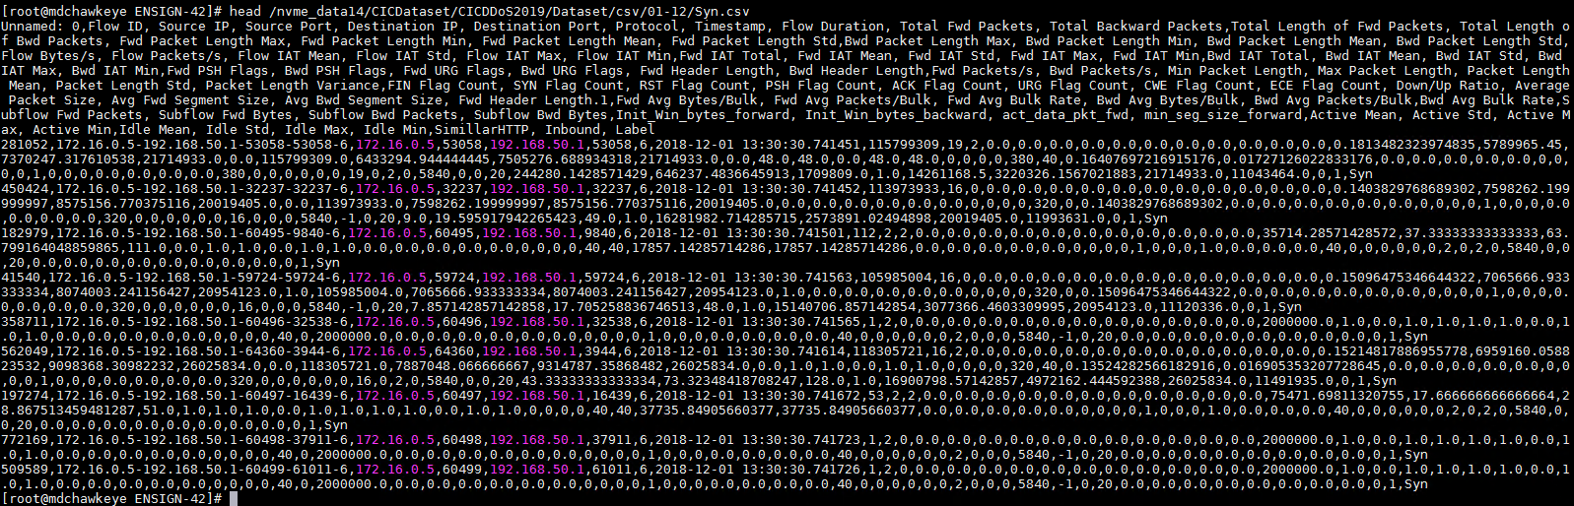
Dataset - CICDDoS2019/Dataset/csv/01-12/Syn.csv
SYN.LOG
[root@mdchawkeye 01-12]# head -1 Syn.csv | sed 's/[^,]//g' | wc -c
88
[root@mdchawkeye 01-12]# wc -l Syn.csv
1582682 Syn.csv
How do we detect DDoS Syn threats patterns
fields
rows
Notes:
https://www.unb.ca/cic/datasets/ddos-2019.html
http://205.174.165.80/CICDataset/CICDDoS2019/Dataset/
https://ieeexplore.ieee.org/document/8888419

Slide 9
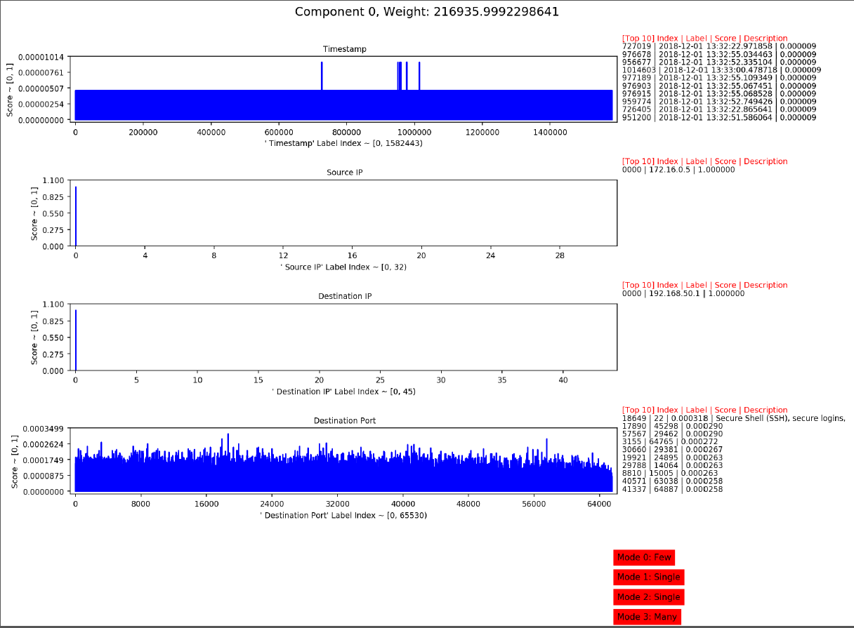
Degree of contribution of this component in input data
Top contributors from input dataset to this component
So why are there so many packets from source (172.16.0.5) to destination (192.168.50.1)?
Why are packets coming and single destination server on multiple ports? In specific timeframe?
Is it indication of DDoS attack on destination(192.168.50.1)?
What kind of TCP/UDP traffic is this indicative of ?
Notes:
comp_top_k.py

Slide 10
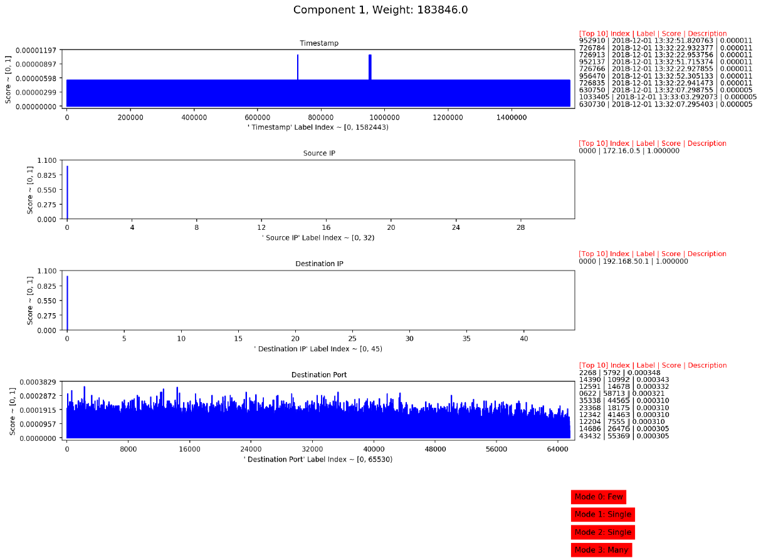
So why are there so many syn packets from source (172.16.0.5) to destination (192.168.50.1)?
Why are syn packets coming and single destination server on multiple ports? In specific timeframe?
Is it indication of DDoS attack on destination(192.168.50.1)?

Slide 11
Spike of DNS port on Destination. Very likely Destination IP is a DNS Server
Analyst can confirm that 4.2.2.4 is a DNS Server
This could very like be a benign traffic and not attack. It could have been attack if 4.2.2.4 is not a DNS Server
Tool separates Components contributing to attack vs benign traffic

Slide 12
HTTP traffic contributing to spikes. Source IPs are indicative of Internal Network and seems outward traffic
Very likely Internet Browsing traffic
Weight is significantly low so it indicates low % contribution to overall traffic

Slide 13
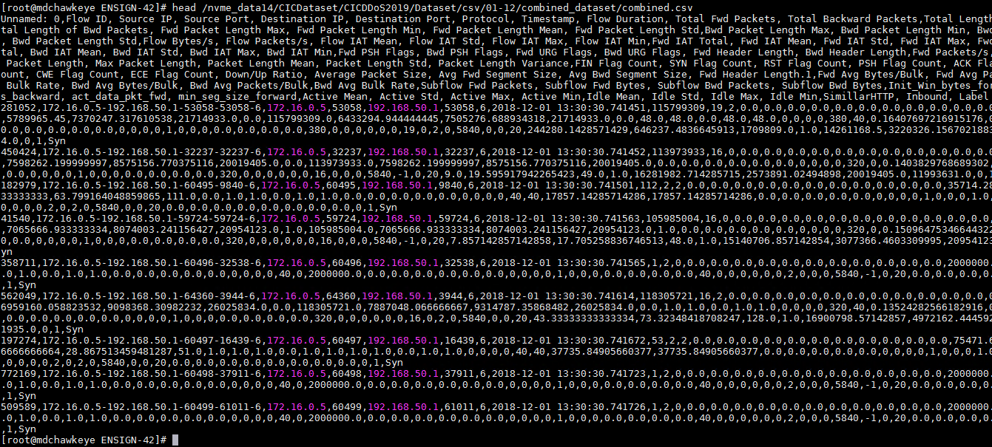
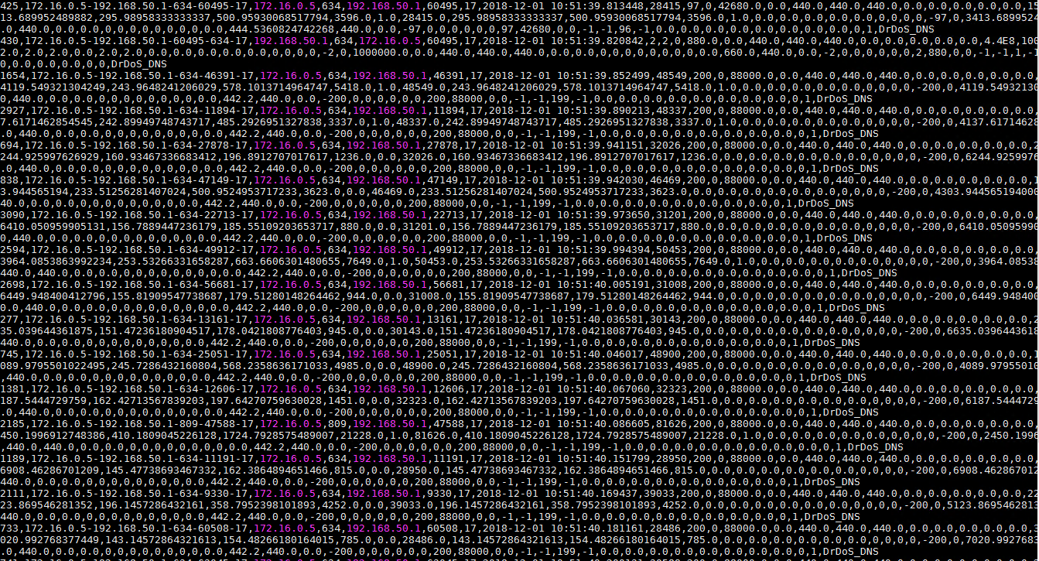
Dataset - CICDDoS2019/Dataset/csv/01-12/(Syn+DNS) combined.csv
[root@mdchawkeye combined_dataset]# du -chs *
2.6G combined.csv
[root@mdchawkeye combined_dataset]# head -1 combined.csv | sed 's/[^,]//g' | wc -c
88
[root@mdchawkeye combined_dataset]# wc -l combined.csv
6657095 combined.csv
How do we detect DDoS Syn threats patterns
SYN.LOG
fields
rows
DNS.LOG

Slide 14
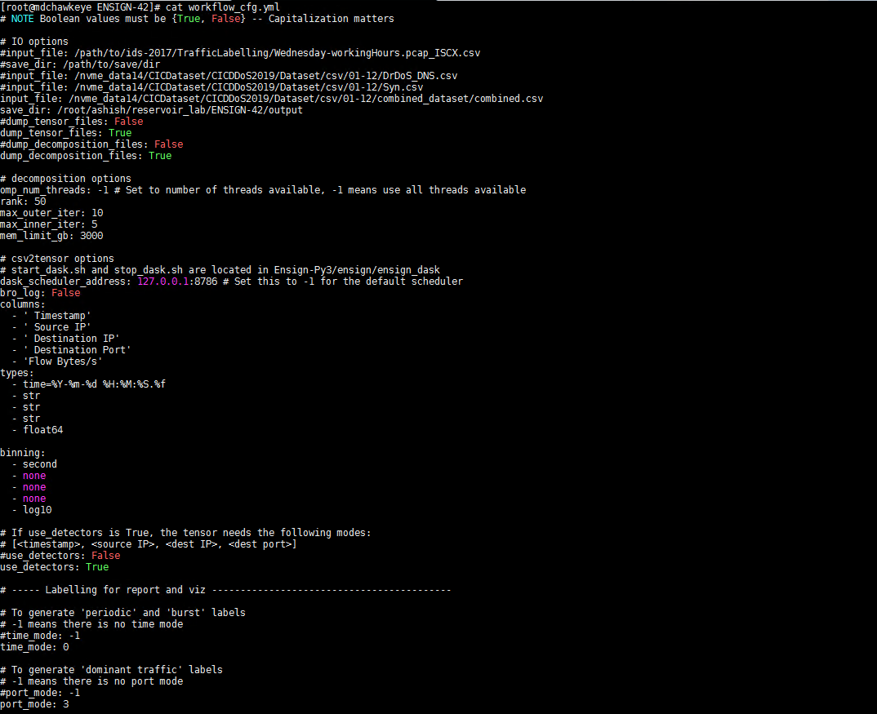
Input data file
Results output directory
Dump intermittent output (tensors)
No of threads for parallel processing
No. of Components for Tensor Decomposition
Max Memory Configuration
Fields to be considered for tensor decomposition
Fields type
Binning/bucketing criteria
Detector specific log output in textual report for example port scanning , network mapping , beaconing etc
[root@mdchawkeye ENSIGN-42]# cd $ENSIGN_BASE
[root@mdchawkeye ENSIGN-42]# workflow.py /root/ashish/reservoir_lab/ENSIGN-42/workflow_cfg.yml | tee console_output_6.txt
End to end tensor decomposition workflow
tensor decomposition workflow config

Slide 15
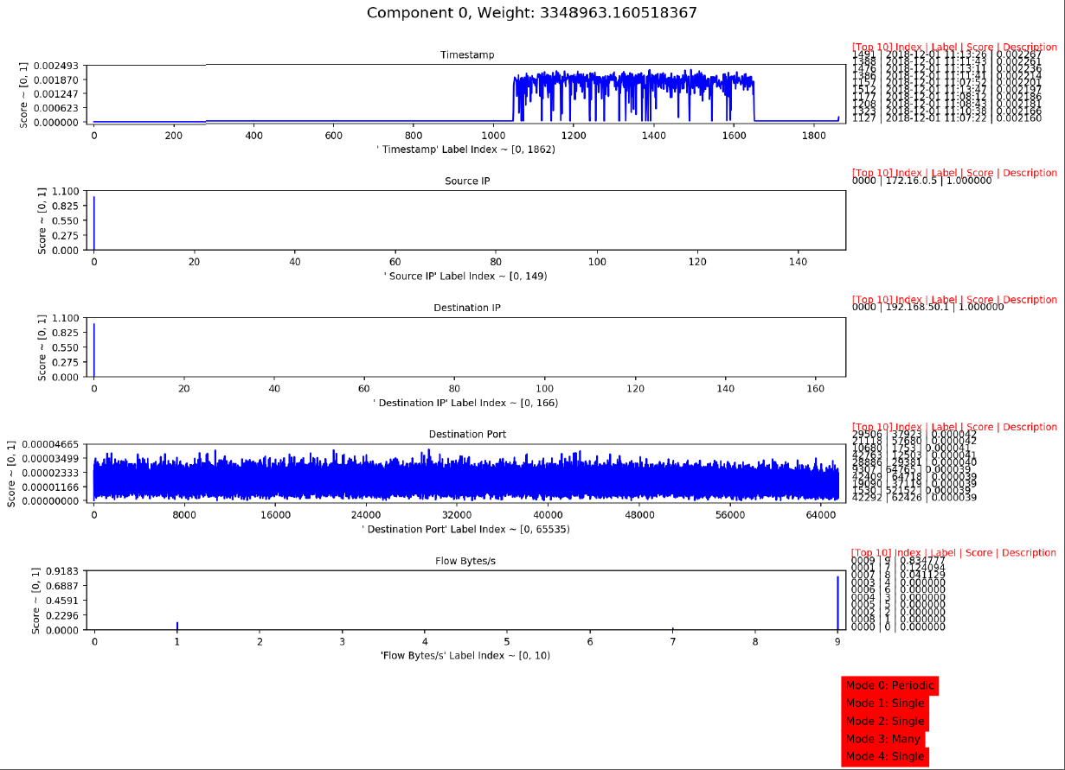
Apart from existing fields, duration and no. of bytes provide good contributions to analysis and hence Flow Bytes is another useful field
Abnormally peak traffic on 2018-12-01 between 11:07 AM and 11:13 AM
Source System = 172.16.0.5 , Destination System = 192.168.50.1
Top ports on Destination Node receiving TCP/UDP data packets
Large no. of bytes.
Indication of DNS Based DDoS Attack

Slide 16
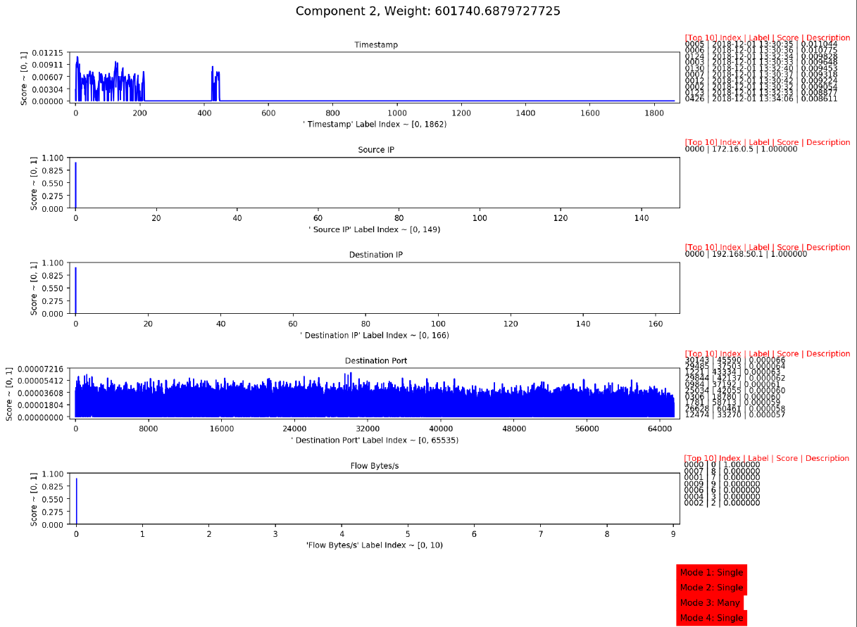
Peak traffic between source = 172.16.0.5 & destination = 192.168.50.1 on 2018-12-01 between 13:30-13:35
Indication of Syn Based DDoS Attack

Slide 17
100% DNS Traffic
8.8.8.8 is DNS Server
Benign Attack

Slide 18
Reverse DNS DDoS attack

Slide 19
Cybersecurity graph analytics – combined workflow
Data (*.csv)
Raw Data
2. Decide on no. of dimensions for tensor-decomposition
(Larger value gives granular analysis)
3. Decide on memory & compute required for tensor-decomposition
(Refer to performance recommend sheet)
4. Decide on the fields (name and type) that would be considered for tensor analysis
Data (*.csv)
Pre-processed for ENSIGN
Data (*.csv)
Pre-processed for xGT
5. Decide on binning/bucketing criteria for the identified fields
6. Convert csv to tensor
7. Perform Tensor Decomposition and generate output using ensign
8. Analyze the output of each component and identify relevant peaks
9. Use backtracking tool and generate subset of input data that contribute to peaks
10. Identified set of potential unknown cyber-threats
Final unified list of Impacted Devices/Nodes (*.csv)
Decide on memory , compute and storage configurations required for xGT Graph Analytics
(Refer to performance recommend sheet)
Build edges and vertices as per input data
Load input data using Trovares Graph Engine
Query/Validate Input data to identify threat

Slide 20
Cybersecurity graph & AI – combined execution Configuration and Performance
COMBINED EXECUTION ENVIRONMENT
ENSIGN |  |  |  |  |  | xGT
Environment Parameters | Combined Execution | Standalone Execution (limited core/memory) | Standalone Execution (full scale) |  |  | xGT 1.3 (LANL Attack Performance) | Combined Execution | Standalone Execution (limited core/memory) | Standalone Execution (full scale)
Python Version | 3.7.4 |  |  |  |  | Python Version | 3.7.4
Python Package Manager | Anaconda |  |  |  |  | Python Package Manager | PyPi
S/W Version | 4.2 |  |  |  |  | S/W Version | 1.3.0
Input Data(GB) - CICDDoS2019 ( DNS+Syn ) | 2.6 |  |  |  |  | Input Data(GB) - LANL Day 85 ( 1v+2v+nf ) | 19.7
Total vCPUs Allocated | 178 | 178 | 448 |  |  | Total vCPUs Allocated | 178 | 178 | 448
Total Memory Allocated (TB) (mem_limit_gb) | 3 | 3 | 6 |  |  | Total Memory Allocated (TB) (system.max_memory) | 3 | 3 | 6
Total No. of Components | 50 | 50 | 50 |  |  | Total No. of Edges | 302,088,856 | 302,088,856 | 302,088,856
csv2tensor(sec) | 232.34 | 62 | 61.322 |  |  | RDP Hack Edges | 10,572 | 10,572 | 10,572
Decomposing tensor w/ CP (sec) | 184.06 | 68.59 | 69.69 |  |  | Total Data Load Time (1v+2v+nf) | 413 | 359 | 143
visualization (sec) | 62.3 | 129 | 135 |  |  | Extract Forward RDP Edges Time (sec) | 1.02 | 1.01 | 1.04
Textual Report Generation (sec) | 1.7 | 2 | 1.6 |  |  | Extract Reverse RDP Edges Time (sec) | 1.03 | 1.02 | 1.04
Total Time Taken (sec) | 480.4 | 261.59 | 267.612 |  |  | Lateral Movement Query Execution Time(sec) | 1.46 | 1.45 | 1.52
CPU Utilization (max) | 100% | 65% | 99% |  |  | CPU Utilization (max) | 100% | 40% | 100%
Note : a) Above results can vary based on configured environment parameters like vCPUs/Memory b) No. of components is critical to performance. As a standard, one could achieve better performance on reduced no. of components c) If intermittent output is not generated then total time taken can be further reduced d) Setup of Client threads using : omp_num_threads = No. of Client Threads e) DASK Server and scheduler configurations using : ./start_dask <uCPUs> f) OpenMP Thread Binding : GOMP_CPU_AFFINITY = 0-178 |  |  |  |  |  | Note : a) Input data size is directly proportional to Total Data Load Time b) Package Manager for xGT & Ensign are different that would require individual environment consideration for xGT & ENSIGN c) vCPU allocation can be further optimized for CPU thread binding but would not impact much on query execution time d) I/O Threads Enabled : system.io_threads=true e) No. of Pinned Threads Configured : system.pin_threads f) No. of worker threads configured : system.worker_threads
Key Observations
ENSIGN Tensor Decomposition phase execution performance degrades in combined environment.
xGT Data Load performance degrades in combined execution environment.
CPU and Memory binding would be required for combined workflow execution
Initial starting configuration for xGT & ENSIGN would 40% CPU allocation and minimum 3TB Memory allocation and scale the resources increamentally

